Slide 1
Eneergy Data Analysis
T V V Yashwanth & Akula Raja prabhu David

Slide 2
Objective:
Analysis of the Energy data analysis, preprocessing

Slide 3
Structure of DataSet
Sample file name (Analysis.ipynb)
Number of rows -11
Number of Columns - 16521

Slide 4
Architecture
Collect data
Data Validation
Data Transformation
Result
Export data to CSV file

Slide 5
Introduction
In the pursuit of cleaner and more diverse energy sources, countries are increasingly turning to renewable energy options like solar and wind power. However, these sources are inherently variable, influenced by factors such as solar radiation intensity, cloud cover, and wind speed. The challenge lies in harnessing this fluctuating energy efficiently. This project addresses the issue by processing raw data collected from energy-related sensors, transforming it into a standardized Gen-1 data format, and organizing it in a structured hierarchy. The raw data is obtained from sensors situated at various substations, including inverters, energy meters (MFM), and a meteorological substation (WMS). These sensors record data streams that are transmitted over the cloud. The raw data undergoes cleansing and transformation, including operations like timestamp extraction and column renaming, resulting in a Gen-1 data format.

Slide 6
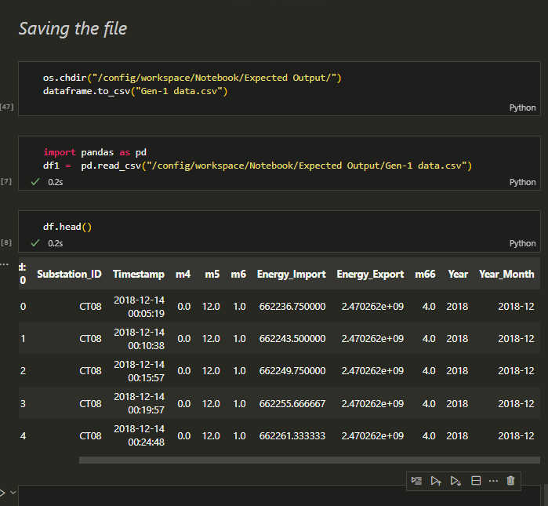
Output

Slide 7
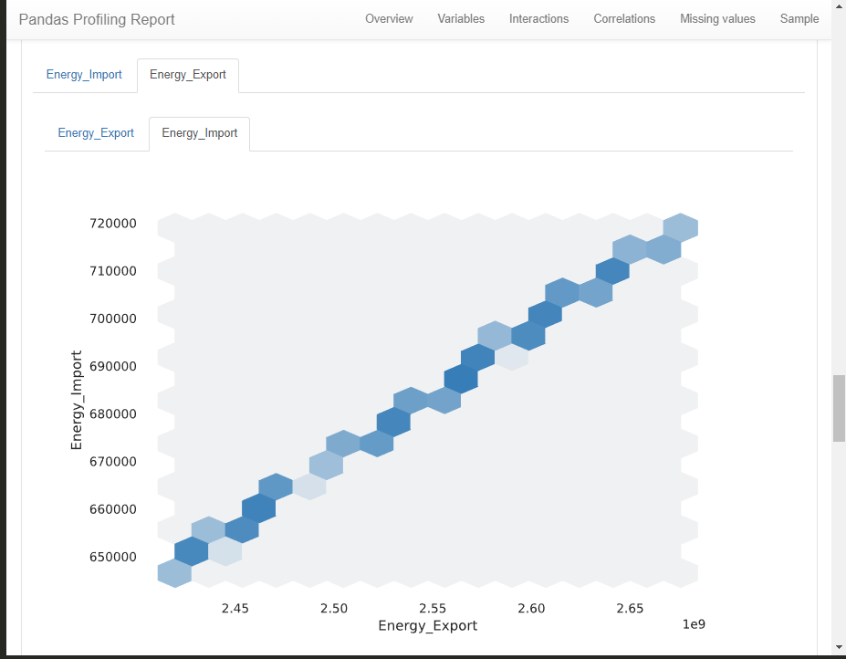
Interactions

Slide 8
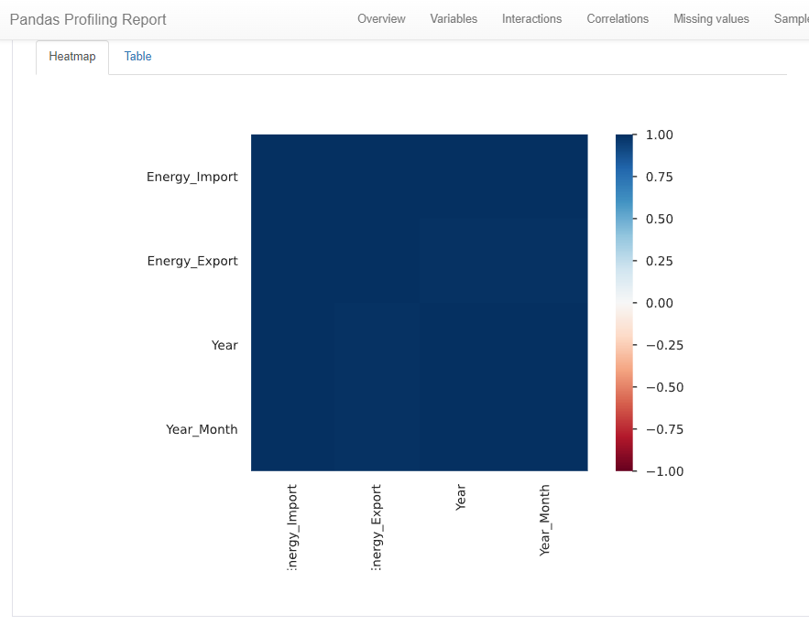
Correlations

Slide 9
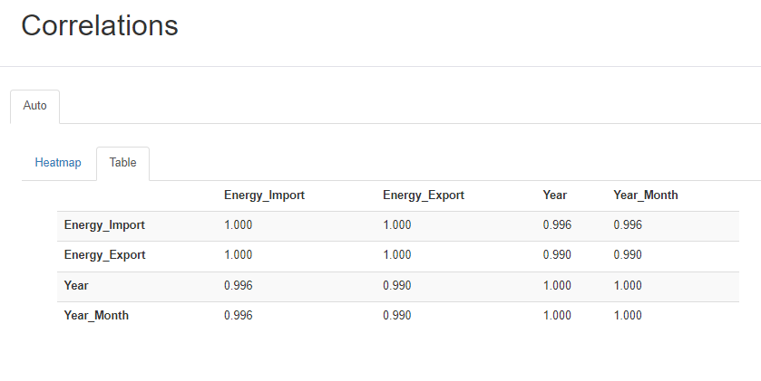
Correlation

Slide 10
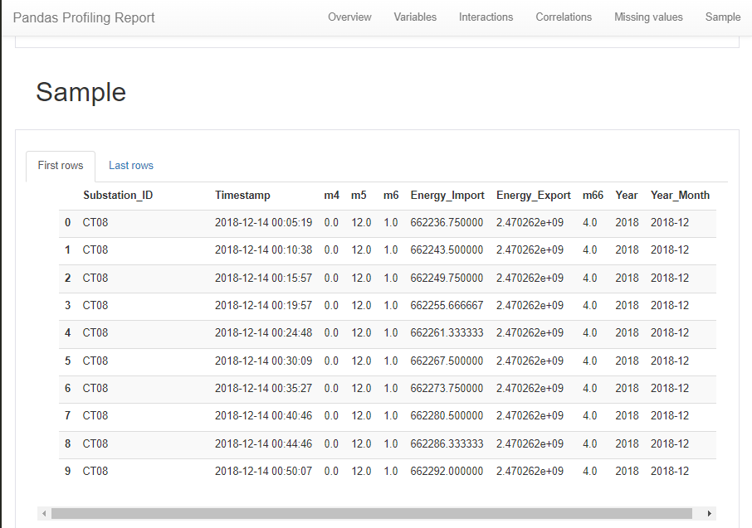
Output

